Slide 1
Ancient Greek for Everyone:
A New Digital Resource for Beginning Greek
2015 edition
Wilfred E. Major
wmajor@lsu.edu

Slide 2
Ancient Greek for Everyone
Χαίρετε, πάντες!
(Welcome, y’all!)
This is a version of a digital textbook developed over some years by a group of scholars dubbed “The Hellenizers.” It is to some extent open- and crowd-sourced. I teach a version of these materials at LSU, but this version is posted on the World Wide Web for students and teachers of Greek everywhere to use and adapt. I ask only that you give fair credit for the use of these materials and that you send corrections to me (wmajor@lsu.edu). I would also ask that you be willing to share additions or variations that you create. My sharing these materials does not license anyone to use them for commercial or profit-making enterprises.

Slide 3
Ancient Greek for Everyone
Ancient Greek for Everyone (AGE) has twenty-four units (one for each letter of the Greek alphabet).
Currently at LSU, we schedule the units as follows:
  First semester: Units 1-10
  Second semester: Units 11-20
  Third semester: Units 21-24 + intermediate reading
The version of AGE posted here sometimes includes information about testing geared to this schedule, but AGE does not intrinsically depend on this schedule. If you are studying or teaching Greek, please feel comfortable adapting this material to your pace, needs and preferences.

Slide 4
Ancient Greek for Everyone
Each unit includes:
one or more Power Points presenting the material
readings from Classical Greek and corresponding core vocabulary
readings in Greek from Biblical writings and corresponding core vocabulary
New in 2015: Dr. Michael Laughy at Washington and Lee University has been using AGE for the last two years. He has generously agreed to share the many additional exercises and review materials he has created for his classes.

Slide 5
Ancient Greek for Everyone
Χαίρετε, πάντες!
(Welcome, y’all!)
This class introduces you to Ancient Greek, primarily as the language of Classical and Biblical texts. By the end of the semester, you will understand simple sentences in Greek and be reading simple texts from antiquity. This ability provides the springboard for you to explore one of the most powerful, captivating, and enduring languages in the world. It is a most excellent journey, not easy, but one which is often quite fun and exciting.

Slide 6
Ancient Greek for Everyone
Each unit includes readings from Classical Greek and corresponding core vocabulary
Classical Greek strictly speaking refers to writings from the city of Athens during the fifth and fourth centuries B.C.
For this reason, the terms Classical Attic (Athenian) and Classical Greek are often used interchangeably.

Slide 7
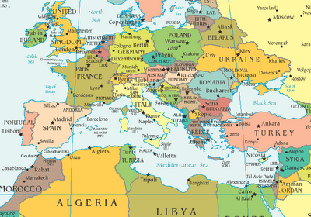
Ancient Greek for Everyone
Athens, capital of Greece, on a modern map
Notes:
http://printable-maps.blogspot.com/2011/11/mediterranean-sea-map.html

Slide 8
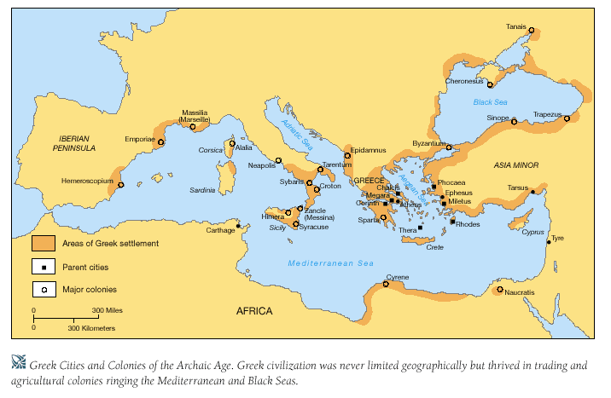
Ancient Greek for Everyone
Athens, Greece in ancient Greece
Notes:
http://resourcesforhistoryteachers.wikispaces.com/7.24

Slide 9
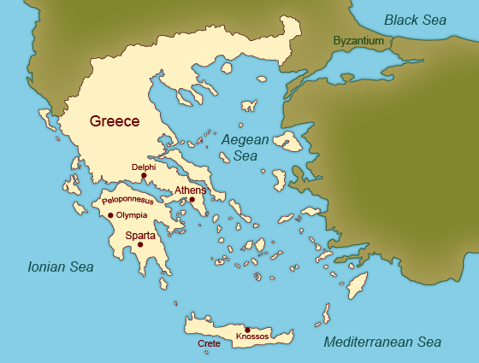
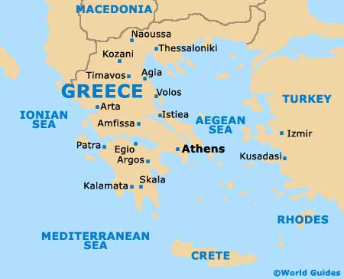
Ancient Greek for Everyone
Classical Greece
Modern Greece
Athens
Notes:
Modern Greece map from http://www.greece.world-guides.com/.
Classical Greece map from http://curriculum.kcdistancelearning.com/courses/WHISTx-HS-A08/a/unit3/html/section_2_page_1.html.

Slide 10
Ancient Greek for Everyone
Classical Greek strictly speaking refers to writings from the city of Athens during the fifth and fourth centuries B.C. These writings include:
Scripts of the world’s first plays, both comedies and tragedies (Aeschylus, Sophocles, Euripides, Aristophanes).
Some of the earliest writings about history (Thucydides, Xenophon).*
The earliest complete writings of philosophy (Socrates, Plato, Aristotle).
Important legal and political writings, as well as the earliest biographies, essays, literary letters, and historical fiction (Xenophon, the canonical orators).
The readings in this course in Classical Greek draw primarily from the above writings.
Notes:
*The ”Father of History,” Herodotus, wrote during this period, but in Ionic Greek, which is a dialect related to, but a little different from, Attic Greek.

Slide 11
Ancient Greek for Everyone
Classical Greek strictly speaking refers to writings from the city of Athens during the fifth and fourth centuries B.C., but it was little read or spoken outside of Athens.
Starting in the third century B.C., Greek become a widespread language all around the Mediterranean area for the next five hundred years.
Attic Greek became the basis for this type of Greek, called κοινή “common” (koine, pronounced “koin=AY”).

Slide 12
Ancient Greek for Everyone
Attic Greek became the basis for this type of Greek, called koine (pronounced “koin=AY”).
The most famous writing in koine Greek is the New Testament.
Hebrew scripture was translated into koine Greek in the second century B.C.E., and this version of the Old Testament, called the Septuagint (abbreviated LXX), was the one known to early Christians.
Other writings from this period related to the Bible were also written in koine Greek.
Notes:
The Septuagint derives its name from the Latin versio septuaginta interpretum, "translation of the seventy interpreters," (Greek: ἡ μετάφρασις τῶν ἑβδομήκοντα, hē metáphrasis tōn hebdomēkonta, "translation of the seventy." The Roman numeral LXX (seventy) is commonly used as an abbreviation.

Slide 13
Ancient Greek for Everyone
The terms Koine and Biblical Greek are often used interchangeably.
Each unit in this course includes readings in Greek from Biblical writings and corresponding core vocabulary
The Biblical readings in this course draw from the New Testament, the Septuagint, and related ancient writings.

Slide 14
Ancient Greek for Everyone
Next
  Review some history about the Greek alphabet.
  Learn some Greek letters!

